Slide 2
CRUSHING
Exp # 1:
Machine Study of Laboratory jaw
Crusher and to perform a crushing
test on the given sample.

Slide 3
CONTENTS
Introduction to Crushing
Introduction to Jaw Crusher
Types of Jaw Crusher
Construction of Jaw crusher
Free Crushing & Choked Crushing
Characteristics of Jaw Crusher
Drawbacks of Jaw Crusher
Application of Jaw Crusher

Slide 4
Introduction to Crushing
What is crushing?
Main objectives of crushing
Types of Crushing
Primary Crushing
Secondary Crushing
Tertiary Crushing

Slide 5
Objectives of Crushing
Handling
Preparing feed size for various machines
Liberation
Size Requirements of finished product

Slide 6
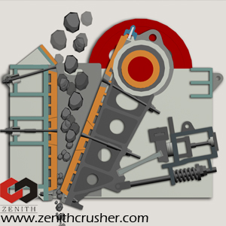
Introduction to Jaw Crusher
What is a Jaw Crusher?

Slide 7
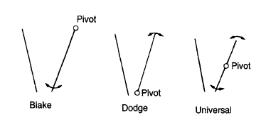
Types of Jaw Crusher
Main types
Blake type
Double toggle Blake type
Single toggle Blake type
Dodge type
Universal type

Slide 8
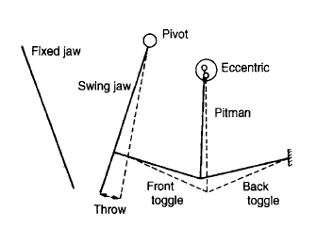
Double toggle Blake type

Slide 9
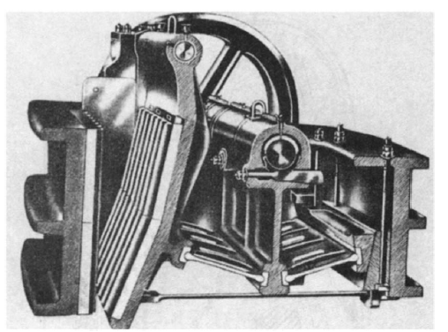

Slide 10
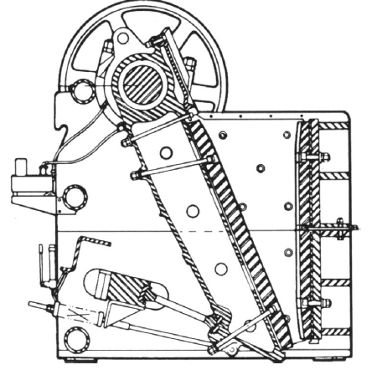
Single toggle Blake type

Slide 11
Comparison B/t Double Toggle & Single Toggle
Parameters
Type of motion
Capacity
Wear
Maintenance cost
Capital cost
Nature of material

Slide 12
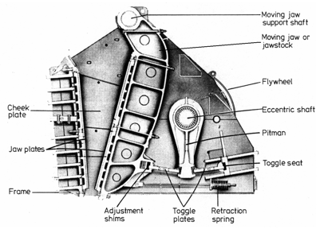
Jaw Crusher Construction

Slide 13
Free crushing & choked crushing

Slide 14
Characteristics of Jaw Crusher
Speed
Throw
Set
Safety Spring
Capacity
Energy requirements
Reduction ration

Slide 15
Drawbacks of Jaw Crusher
180 degree machine
Not suitable for stick Material
Lumps passes without crushing

Slide 16
Applications of Jaw Crusher

Slide 17
Crushing
Exp # 2.
Machine Study of Laboratory
Roll Crusher & to perform a
crushing test on it.

Slide 18
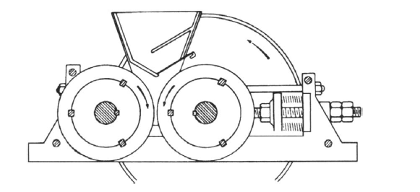
Introduction to Roll Crusher

Slide 19
Types of Roll Crushers
Single Roll type
Double Roll type
Three Roll Type
Four Roll Type

Slide 20
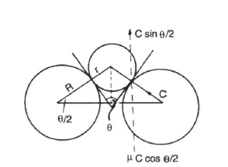
Parameters affecting performance
Angle of nip
Size of roll
Speed of roll
Surface of rolls

Slide 21
Capacity & Reduction Ratio

Slide 22
Applications & drawbacks
Friable, sticky and soft material

Slide 23
Questions

