Slide 1
Properties, Handling and Mixing of Particulate Solids
By
Sidra Jabeen
Department of Chemical Engineering,
University of Engineering & Technology Lahore

Slide 2
Particle Size
Some particles conform to standard configuration like;
Spherical
Cylindrical
Cubical
Some do not conform to any of these standard configurations →Irregular shape particles

Slide 3
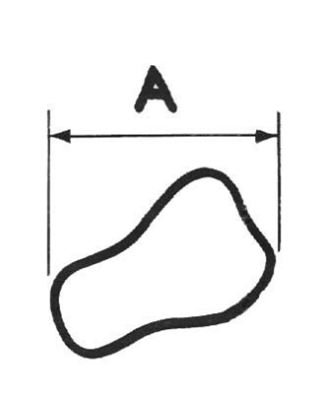
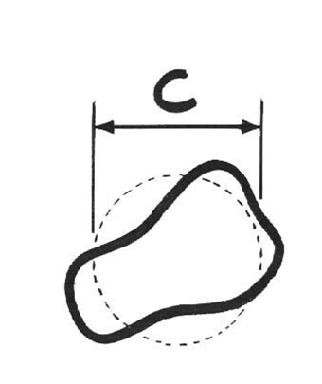
Particle Size
Feret’s Diameter
Projected area Diameter

Slide 4
Particle Size
Latest system of defining particle size is by comparison with standard configuration (sphere) → That is called the equivalent size / equivalent diameter or Equivalent Spherical Diameter (ESD) of irregular particle defined as:
The size of the spherical particle having the same controlling characteristics as the particle under consideration.

Slide 5
Particle Size in terms of controlling characteristics
Controlling characteristics depends upon the system or process in which the particle is involved. Consider few examples:
For defining the size of catalyst particle, surface area is chosen as controlling characteristics.
Surface diameter: Diameter of the spherical particle having the same surface area as the particle.

Slide 6
Particle Size in terms of controlling characteristics
2. Settling velocity of particle in a liquid is very much controlled by the volume of the particle.
Volumetric diameter: Diameter of the spherical particle having the same volume as the particle under consideration.

Slide 7
Particle Size in terms of controlling characteristics
3. Motion of liquid drops in a gas depend not only on liquid drop volume but also at surface tension at the gas-liquid interface. Both the volume and surface area of liquid drop are controlling parameters here.
Volume Surface diameter: Diameter of the spherical particle having the same volume per unit surface area as the liquid drop under consideration.

Slide 8
Mixed Particle Sizes and Size Analysis
Consider the mixture of particles having various sizes, the particle size distribution can be represented in two forms;
Differential analysis
Cumulative analysis

Slide 9
Mixed Particle Sizes and Size Analysis
For mixtures of particles having various sizes and densities, the mixture is sorted into fractions; each of constant density and approx. constant size. Each fraction can be then weighed or no. of particles counted or measured by no. of methods. Equations are applied to each fraction and the results added.

Slide 10
Differential Analysis
Mass fraction in each size increment is tabulated and plotted as a function of size range of particles. Results represented as a histogram.
It is obtained by adding, consecutively, the individual increments, starting with that containing the smallest particles and tabulating or plotting the cumulative sums against the size range (diameter) of particles. Data is represented as a continuous curve.
Cumulative Analysis

Slide 11
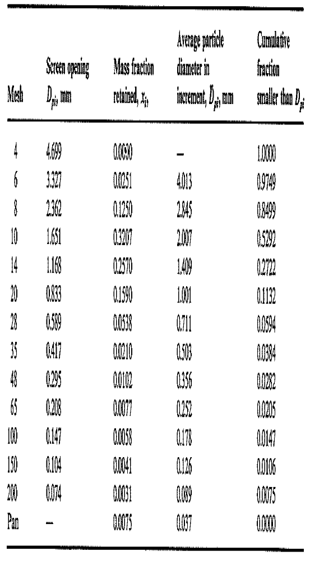

Slide 12
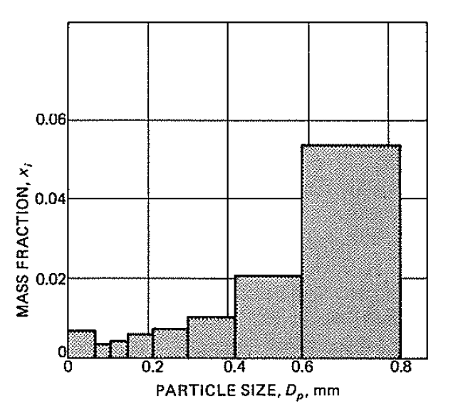
Differential Analysis

Slide 13
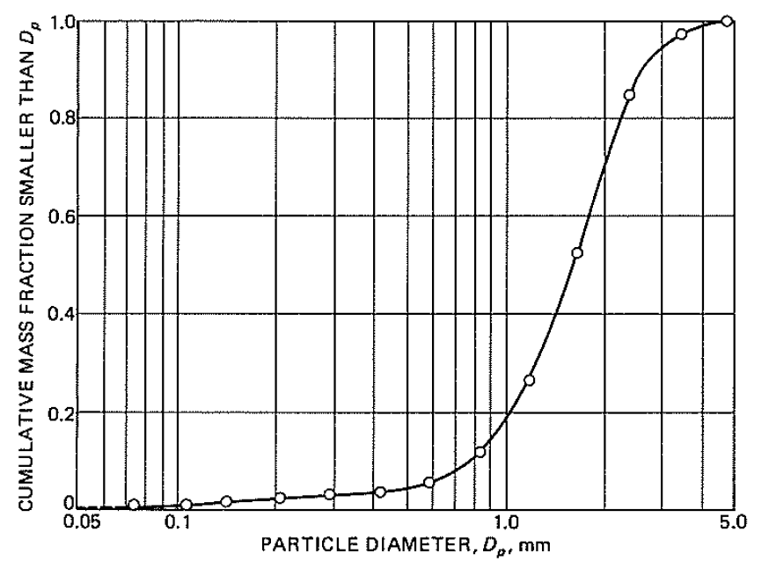
Cumulative Analysis

Slide 14
Specific Surface of mixture
Specific surface of mixture is total surface area per unit mass of the particles.

Slide 15
Average Particle Size
The average particle size for a mixture is defined in a number of ways.
Volume-surface mean diameter or Sauter mean diameter (SMD)
Arithmetic mean diameter
Mass mean diameter
Volume mean diameter

Slide 16
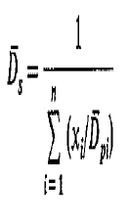
Average Particle Size
Volume-surface mean diameter or Sauter mean diameter (SMD)

Slide 17
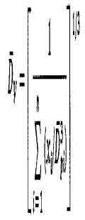
Average Particle Size
Arithmetic mean diameter
Mass mean diameter
Volume mean diameter

