Slide 2
PARTICLE TECHNOLOGY
By
Sidra Jabeen
Department of Chemical Engineering,
University of Engineering & Technology Lahore

Slide 3
Course Details
Subject Subject code Contact hours Credit hours Sessional Mid term Final term | Particle Technology (Theory) Ch.E - 102 3 3 30 % (Quizzes + Attendance + Class participation) 30% 40%
Evaluation procedure

Slide 4
Course Outline (1)
Introduction to Chemical Engineering
Importance of Particle Technology in chemical process industries
Shape and size of the particles
Fundamentals of the following Unit Operations: screening, conveying, mixing, size reduction and size enlargement
Different types of screening equipment, conveyors, mixer, size reduction equipments and crystallizers

Slide 5
Course Outline (2)
Introduction to separation processes
Role of mechanical separations in chemical processing
Fundamentals of following mechanical separations: filtration, sedimentation, clarification, flotation, centrifugal separations, jigging, tabling, Magnetic and Electrostatic separations, sonic agglomeration
Different type of filters, cyclones, centrifuges, flotation cells, Electrostatic precipitators, Magnetic Separators and settling tanks.

Slide 6
Recommended Books
Text Book Reference Books | McCabe Warren L., Smith Julian C., Harriott Peter “Unit Operations of Chemical Engineering” 5th Ed. 2001. McGraw Hill Inc. Coulson J.M., Richardson J.F., “Chemical Engineering” Vol-II, C.M. Narayanan & B. C. Bhattacharya., “Mechanical Operations for Chemical Engineers” Khanna Publisher Perry Robert H., Green Don W. “Perry’s Chemical Engineering handbook” 7th Ed. 1997. McGraw Hill Inc. Particulate technology by Clyde Orr, Jr. McMillan Company NewYork 1966. Mineral Processing Technology Vol. 29 Ed 3rd By B.A. Wills Pergamon Press . Foust and Wenzel “Unit Operations of Chemical Engineering”

Slide 7
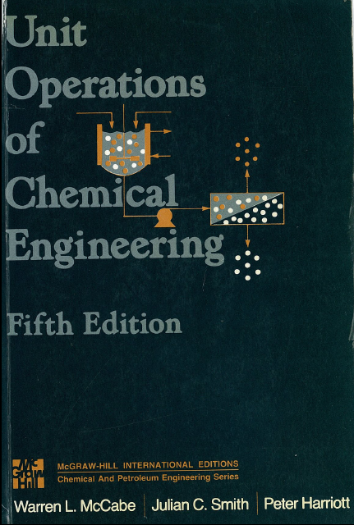
Text book
“Unit Operations of Chemical Engineering”
5th Ed.
By Warren L. McCabe, Julian C. Smith & Peter Harriott

Slide 8
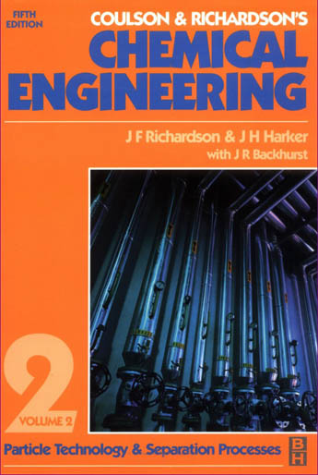
“Chemical Engineering” 2nd volume
5th Ed.
By J. F. Richardson & J. H. Harker with J. R. Backhurst

Slide 9
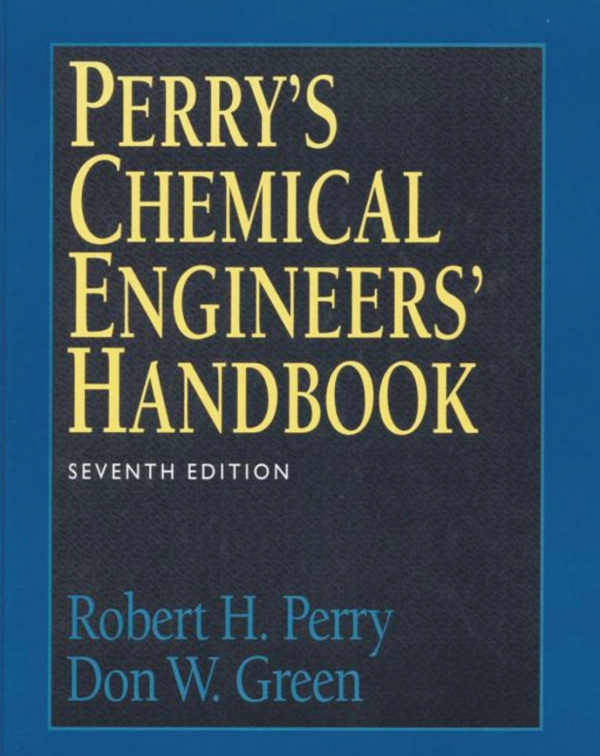
Perry’s Chemical Engineering Hand book
Seventh Edition
By Robert H. Perry
Don W. Green

Slide 10
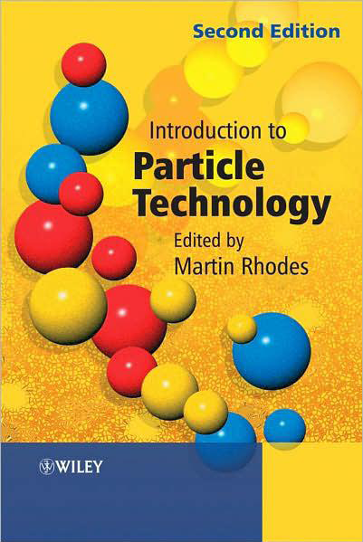
Introduction to Particle Technology
Second Edition
By Martin Rhodes

Slide 11
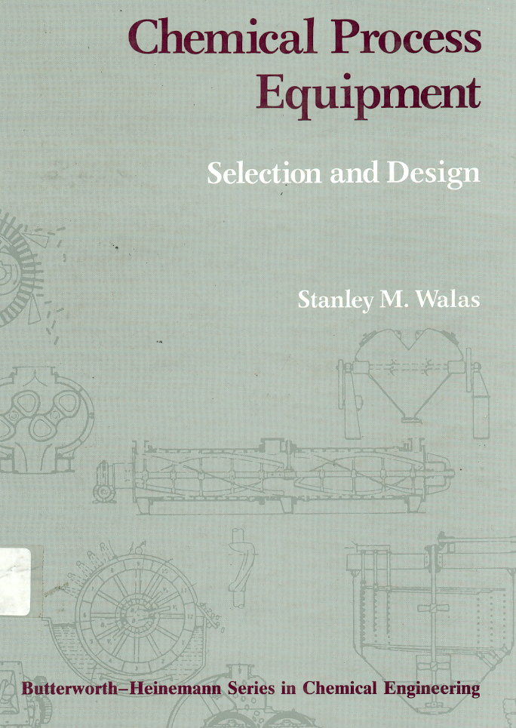
Chemical Process Equipment
Selection and Design
By Stanley M. Walas

Slide 12
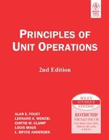
Principles of Unit Operations
2nd Edition
By Alan S. Foust, Leonard A. Wenzel, Curtis W. Clump, Louis Maus, L. Bryce Anderson

Slide 13
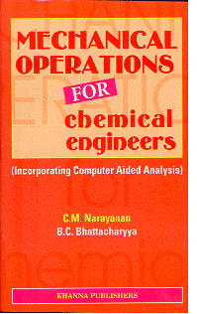
Mechanical Operations for Chemical Engineers
By C.M Narayanan, B.C. Bhattacharyya

Slide 14
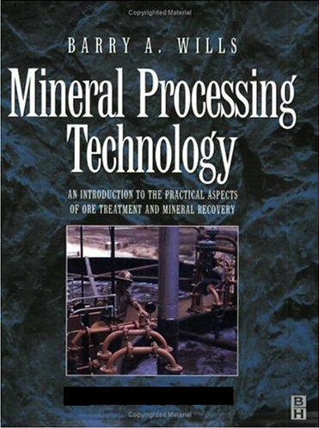
Minerals Processing Technology
3rd Edition
By Barry A. Wills

Slide 15
What???
Particle is an object to which can be ascribed several physical properties such as volume or mass. The word is rather general in meaning, and is refined as needed by various scientific fields.
Technology is the making, modification, usage, and knowledge of tools, machines, techniques, systems and methods of organization, in order to solve a problem, achieve a goal or perform a specific function.

Slide 16
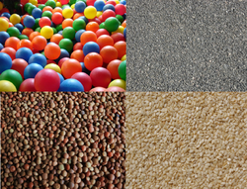
Particle Technology
Particle Technology is that branch of Science and Engineering dealing with the production, handling, modification, and use of a wide variety of solids, both wet or dry; its scope spans a range of industries to include chemical, petrochemical, agricultural, food, pharmaceuticals, mineral processing, advanced materials, energy, and the environment.

Slide 17
Unit Operations
Processes that involve only physical changes to materials is termed as Unit Operation
Particle Technology
Mechanical Separations
Fluid Mechanics
Process Heat transfer
Mass Transfer
Simultaneous Heat and Mass Transfer

Slide 18
Unit Processes
Processes that involve making chemical changes to materials as a result of chemical reaction. Unit processes are also referred to as chemical conversions.
Nitration
Esterification
Halogenations
Sulphonation
Oxidation
Hydrogenation
Amination
Biochemical processes

