Slide 1
Size Reduction
By
Sidra Jabeen
Department of Chemical Engineering,
University of Engineering & Technology Lahore

Slide 2
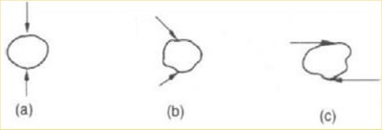
Size Reduction
Large size particles are converted into smaller particles. The process is also called as comminution.

Slide 3
Size Reduction Methods
Compression
Impact
Attrition/rubbing
Cutting/Shear

Slide 4
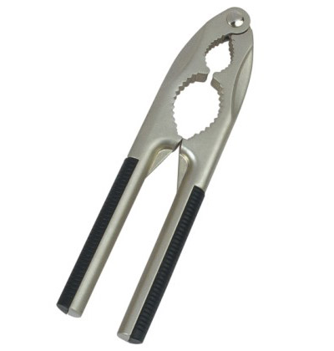
1- Compression
Gripping + compressing between two surfaces
Work done by both surfaces
Feed:
Very coarse
Abrasive
Non-sticky
Product: relatively coarser
Example: Nut cracker

Slide 5
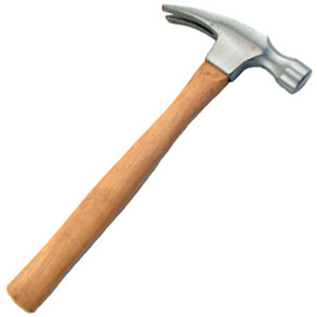
2- Impact
Striking / collision of one body to another moving body
Gravity impact
Dynamic impact
Feed:
Brittle
hard
Abrasive
High moisture
Product: fines, intermediate, some coarse
Example: Hammer

Slide 6
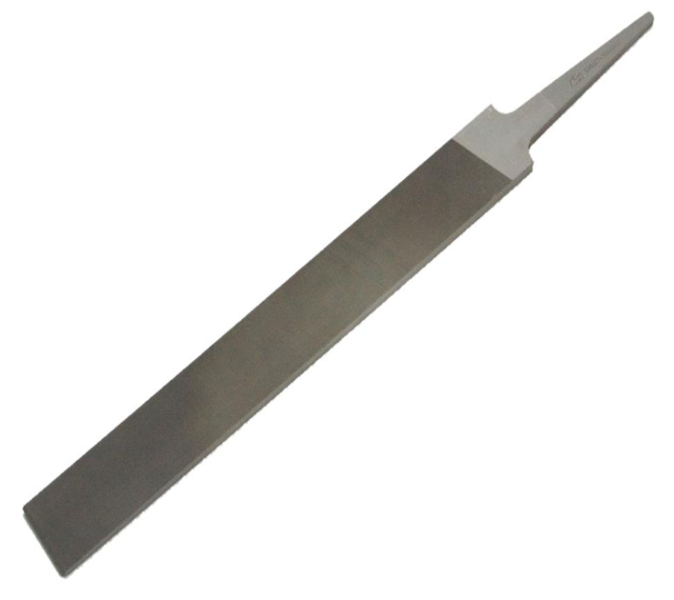
3- Attrition/ Rubbing
Sliding / scrubbing / rolling of material with surface or each other
Feed:
Soft
Non-Abrasive
Product: fines
Example: file

Slide 7
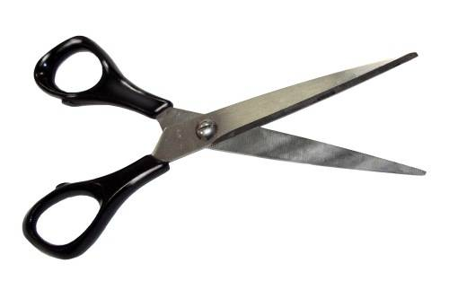
4- Cutting / Shear
Slipping of planes
Trimming action
Feed:
Ductile
Fibrous
Product: definite shape / definite size – no fines
Example: Pair of shears

Slide 8
Criteria for Comminution
Performance Parameters
Capacity
Energy requirement
yield
Ideal Comminution Equipment
High Capacity
Small energy requirement per unit product
Yield a product of single size or size distribution
Performance Evaluation:
Ideal operation is taken as standard
Compare the actual with existing one
Not feasible for crushing & grinding because of large deviation
Empirical relations

Slide 9
Characteristics of Comminuted product
Objective
Small particles from larger one
Small particles are desired
Either b/c of their large surface
Or b/c of their shape, size & number
Non uniform product – mixture of different sizes
Ranging from max. particle size (coarse) to min. particle size
Ratio of diameters of largest and smallest particle is of the order of 10⁴
Comminuted products are smoothed by abrasion and their size is specified

Slide 10
Energy & Power requirement
Cost of power and energy is major expense
Mechanism involved in size reduction
Material feed is distorted and strained
Energy is stored as mechanical energy of stress
Additional force beyond ultimate strength
Fracture occur
New surfaces generated
Energy
To run equipment
losses

Slide 11
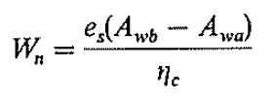
Crushing efficiency
Efficiency = Output / Input
Crushing efficiency is the ratio of surface energy created by crushing to the energy absorbed by the solid
e_{s} = surface energy created per unit area
ΔA_{w} = specific surface created per unit mass
W_{n} = mechanical energy absorbed per unit mass of material
As e_{s} <<< W_{n}
Efficiency <<< 1

Slide 12
Mechanical efficiency
Mechanical efficiency = Energy absorbed by solid / Energy supplied to machine
Where W = Energy supplied to machine

Slide 13
Power requirement
If m = feed rate
Then P = mW
or

Slide 14
Laws of Size Reduction
To express energy required for size reduction of a solid material in terms of the sizes of feed and products.
Energy required depends on:
Amount of material
Composition and structure
Nature of equipment
Size of particle
For same reduction ratio, the energy required for reduction of unit mass of solid material in a given machine is higher for smaller particles.

Slide 15
Rittinger Law (1867)
“Work required to crush a given amount of material is proportional to new surface created / increase in specific surface”
Hypothesis
Energy requirement is usually 200-300 times that required for creation of new surfaces.

Slide 16
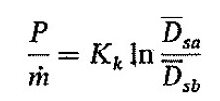
Kick’s Law (1885)
“Work required for crushing a given amount of material is constant for same reduction ratio”
Unrealistic
Same energy to convert 10 μm to 1 μm and 1 m to 10 cm

Slide 17
Bond’s Law (1952)
“Work required to form particle of size D_{p} from very large feed is proportional to square root of the surface to volume ratio of the product”

Slide 18
Work Index
Gross energy required in kWh per ton of feed needed to reduce very large feed to such a size that 80% of the product passes a 100 μm screen
If 80% of feed passes from mesh size D_{pa} and 80% of product of mesh size D_{pb}

Slide 19
Differential form of Laws
Generalized differential equation for given cases
N = 1, Kick’s Law
N = 2, Rittinger’s Law
N = 1.5, Bond’s Law

Slide 20
SIZE-REDUCTION EQUIPMENTS

Slide 21
Size Reduction Equipments
The principal types of size-reduction machines are as follows:
A. Crushers (coarse and fine)
1. Jaw crushers
2. Gyratory crushers
3. Crushing rolls
B. Grinders (intermediate and fine)
1. Hammer mills, Impactors
2. Attrition mills
3. Tumbling mills
a. Rod mills
b. Ball mills
C. Ultrafine grinders
1. Fluid-energy mills
2. In. Classified H.M
3. Agitated Mills
D. Cutting machines
1. Knife cutters, slitters
Coarse mine material is crushed into lumps of 250 to 150 mm. Again these lumps are broken into particle of 6 mm in size.
Grinders reduce crushed feed to powder. The product from an intermediate grinder might pass a 40-mesh screen and product from fine grinders pass a 200-mesh screen with a 74 μm opening.
Feed < 6 mm
Product: 1- 50 μm
Give particles of definite size and shape, 2 to 10 mm in length

Slide 22
Crushers
Slow-speed machines
coarse reduction
large quantities of solids.
The main types are
jaw crushers
gyratory crushers
smooth-roll crushers
Toothed-roll crushers
The first three operate by compression and toothed-roll crushers tear the feed apart as well as crush it.

Slide 23
Jaw Crushers
Two jaw - V opening
One – Fixed jaw – anvil jaw
Other – moving jaw – swinging jaw
Angle b/w jaws 20º – 30º
Jaws are flat or slightly bulged
crushed at upper portion & then dropped and recrushed at narrow end
250 – 400 times per min
Feed size = 1.8 m and product size = 250 mm
Capacity = 1200 ton/hr

Slide 24
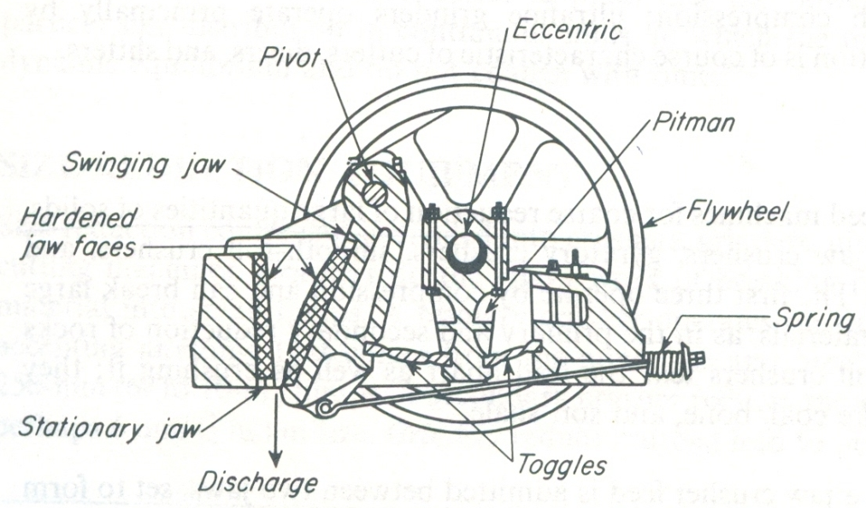
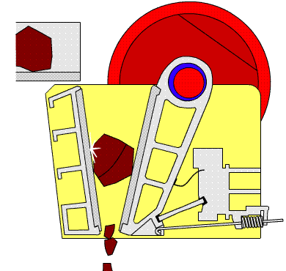
Jaw Crushers

Slide 25
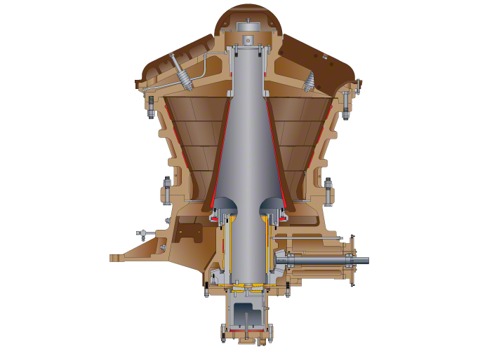
Gyratory Crushers
Jaw crusher with circular jaws
Conical crushing head
Funnel shaped casing open at the top
Crushing head is carried on heavy shaft
solid broken and re-broken again & again
125-425 gyrations per min
motion – Slow
Product – continuous
Capacity – 4500 ton / hr
Relatively less power as well as maintenance required

Slide 26
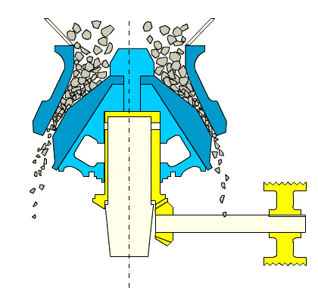
Gyratory Crushers

Slide 27
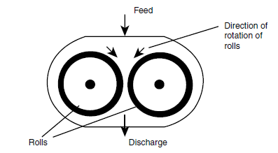
Crushing Rolls
Heavy rolls rotating at slow speeds
two heavy smooth faced metal rolls
turning on parallel horizontal axis
compression b/w rolls and then drop out
turn to each other with same speed
50 – 300 rpm
narrow faces as compared to diameter
feed 12 – 75 mm
product 12 – 1 mm
R.R < 5

Slide 28
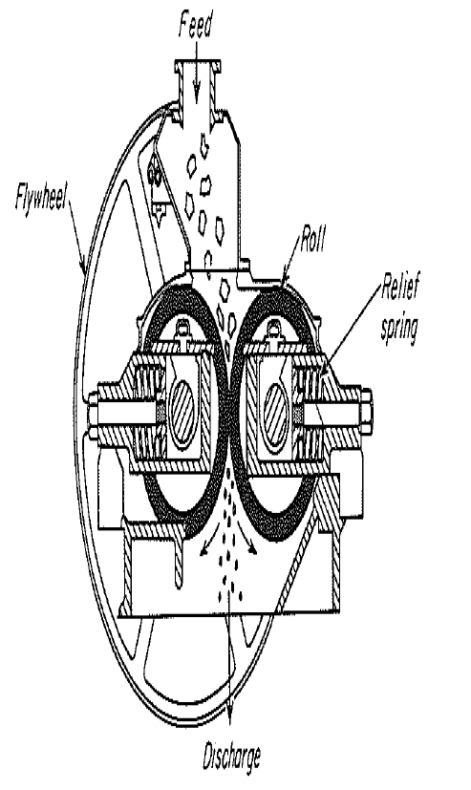
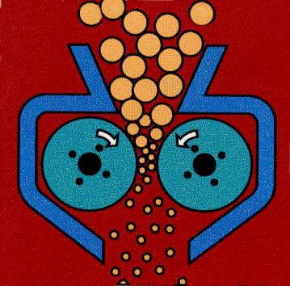
Crushing Rolls

Slide 29
Toothed Roll crusher
Roll faces – corrugations , breaker bar, teeth
may be One roll or Two rolls
One roll working again a stationary curved breaker plate
Disintegrators – two corrugated rolls – different speeds
Small high speed rolls with transverse breaker bars on its face turning toward a large slow speed smooth rolls
versatile but cannot handle very hard material
Compression + Impact + Shear
Feed < 500 mm
Capacity upto 500 tons/hr

Slide 30
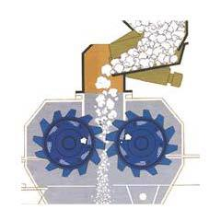
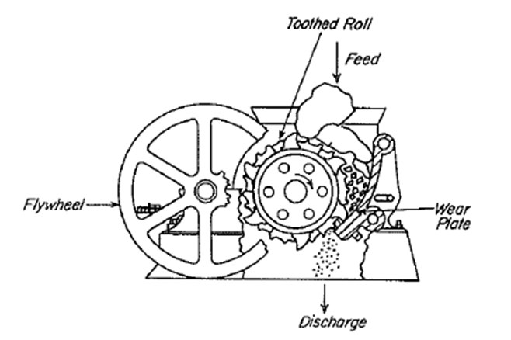
Toothed Roll crusher

Slide 31
Grinders
The term grinder describes a variety of size-reduction machines for intermediate and fine duties.
The product from a crusher is often fed to a grinder, in which it is reduced to powder.
The types of commercial grinders are hammer mill, impactors, attrition mills and tumbling mills.

Slide 32
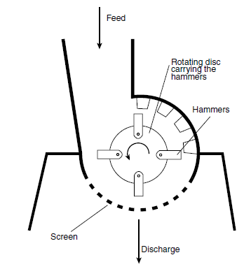
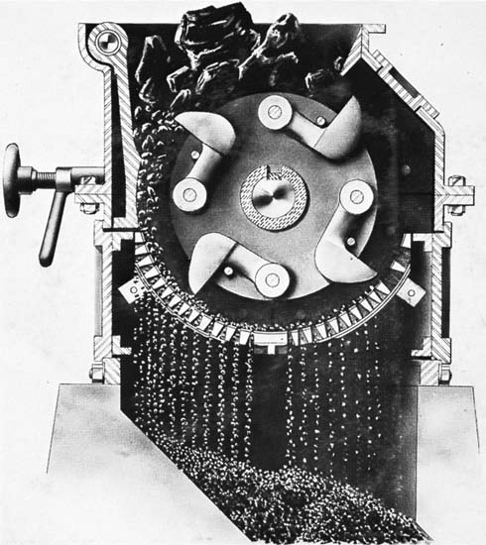
Hammer Mills
High speed rotor
Cylindrical casing
Horizontal shaft
Swing hammers attached with rotor
Hammers – impact + rubbing
Discharge opening – Screen
Feed (top) – Break(casing) – Product (bottom)
4 – 8 hammers on single shaft
Intermediate – 25 mm to 20 mesh size
Fine - < 200 mesh at 0.1 to 15 ton/hr
Versatile
Capacity & Power req. – feed nature
Reduce 60 – 240 kg per kWh

Slide 33
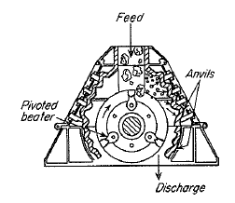
Impactor
Heavy duty hammer mill except screen
Impact alone
Primary reduction machine
Capacity = 600 TPH
Nearly equi-dimensional particle

Slide 34
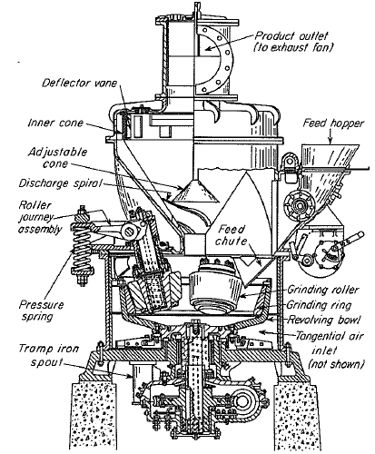
Rolling Compression Machines
Cylindrical rollers
Stationary anvil ring or casing
Horizontal shaft
Moderate speed
Plows – lifting the material
Some time ring or bowl is driven
Product swept with the help of air
Capacity = 50 ton / hr
99% product pass through 200 mesh

Slide 35
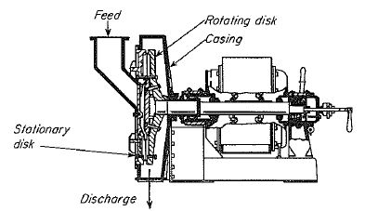
Attrition Mills
For soft solids
corrugated or flat faces of rotating circular disk
Horizontal axis , sometimes vertical
Single runner mill – one disk is stationary and one rotates
Double runner mill– both disks are driven – high speeds
Product – very fine / powders
Air is drawn – to get product
cooling is essential
Speed – 350 to 700 rpm ( single )
- 1200 to 7000 rpm (Double)
Capacity 0.5 to 8 ton/hr , - < 200 mesh
8 – 80 kWh per ton

Slide 36
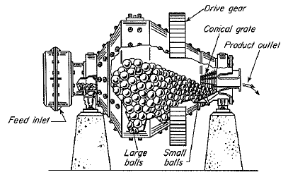
Tumbling Mills
Cylindrical shell
Slowly turning about its horizontal axis
Half filled by solid grinding medium
Grinding medium
metal rods in Rod mill
balls of metal, rubber or wood in Ball mill
pebble, porcelain or zircon spheres in pebble mill
Operation - Continuous or Batch
Impact + attrition
Product - fines

Slide 37
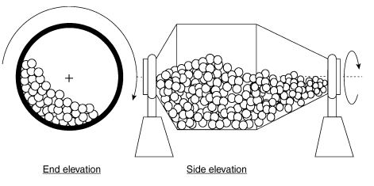
Rod Mills
Rolling compression + attrition
Several sizes of rods – 25 to 125 mm in diameter
intermediate grinders
20 mm feed to 10 mesh product
Impact + Compression
ball 25 to 125 mm
Pebble 50 to 175 mm
Ball Mill or Pebble Mills

Slide 38
Capacity & Power requirement in Tumbling mills
Amount of Energy supplied depends upon
Mass of grinding media
speed of rotation
Max. distance of fall
Best predicted by computer simulation based on experimentation
Rod mill – 5 to 200 ton/h of 10-mesh product – 4 kWh/t
Ball mill – 1 to 50 ton/h of 70 to 90% of 200-mesh – 16 kWh/t

Slide 39
Ultrafine Grinders
All particles passing a standard 325-mesh (44 μm)
high speed hammer mill with internal classification
Fluid energy or jet mills
Agitated mill (wet)
Colloid Mills

Slide 40
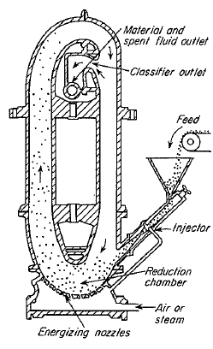
Fluid Energy Mills
Particles suspended in high velocity gas stream (fluidization)
Elliptical or circular path
inter - particle interaction + striking + rubbing
Coarse particles remain in circulation
Working
product – 0.5 to 10 μm
Feed – 1 ton/hr - non sticky
1 – 4 kg of steam or 6 – 9 kg of air
per kg of product

Slide 41
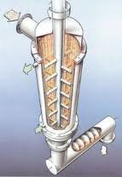
Agitated Mills
Small batch non rotary mills
solid grinding medium (hard solids like balls or pebbles)
vertical vessel – 4 to 1200 L
filled with liquid and suspended medium
feed is agitated by the impeller
Feed - Concentrated slurry
Product – bottom (through the screen)
product – 1μm or finer

Slide 42
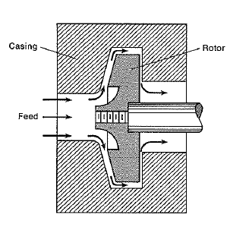
Colloid Mills
Feed pumped between closely spaced surfaces
One moving relative to other
cooling is required
low capacity – 2 to 3 L/min – 440 L/min
Feed - Concentrated slurry
product – 1μm or finer

Slide 43
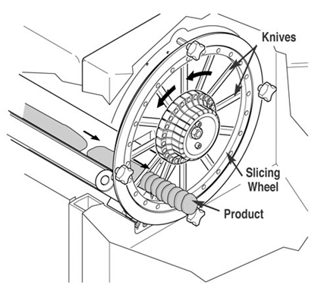
Cutting Machines
feed – sticky , hard and elastic
size reduction with fixed dimensions
cut, chop or tear the feed
rotary knife cutters or Granulator
Rubber and plastics

Slide 44
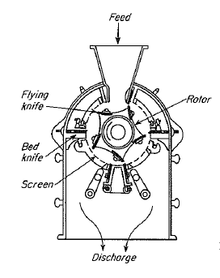
Knife cutter
Horizontal rotor in cylindrical chamber
200 – 900 rpm
2 to 12 flying knives with sharp edges
1 to 7 stationary knives
feed – reduces several hundred times
knives at angle or parallel to each other
Granulators yield more or less irregular particles while cutters yield cubes, thin square or diamond shapes

Slide 45
Equipment Operation
Size reduction equipment performs satisfactorily when
Feed is of suitable size entering at uniform rate
Product is removed as soon as possible as the particles are of desired size
Unbreakable material is kept out of machine
Heat generated is removed

Slide 46
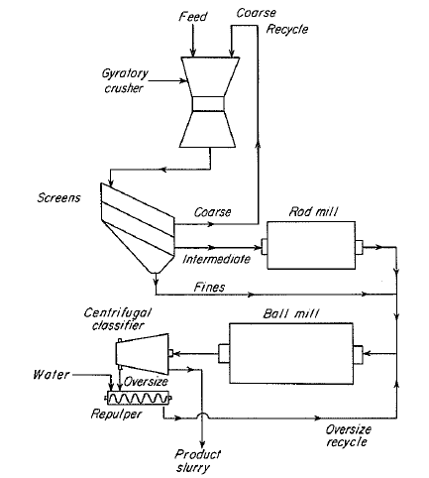
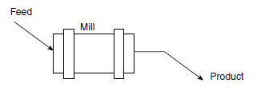
Equipment Operation
Open-circuit → material is passed only once through machine
Closed-circuit → oversize material is recycled for second cycle of crushing
Closed circuit
Open circuit

Slide 47
Feed Control
Appropriate size
Not too large
Not too small

Slide 48
Feeding and Discharge
Free feeding → feeding at low rate so that product escape out readily
Choke feeding → machine kept full and discharge impeded
Free discharge → coarse particles fall of the mill readily
Peripheral discharge → through opening in chamber wall at one end
Trunnion discharge → material drop into cone, which directs it out

Slide 50
Wet vs. Dry Grinding
Power consumption is reduced
Capacity is increased
Product removal is easier
Dust formation is eliminated
More wear on chamber walls and grinding media

Slide 51
Energy consumption
Enormous quantities of energy
Most inefficient of all unit operations
99% energy goes to operating equipment, heat, sound and vibration
Energy consumption is higher for fines than coarse particles

Slide 52
Removal or Supply of Heat
Temperature rise during size reduction occurs, which may melt or decompose solids.
Cooling methods are:
Cooling water
Refrigerated brine
Air is blown
Solid carbon dioxide
Liquid nitrogen
Tough materials become brittle to be broken easily

