Slide 1
Properties, Handling and Mixing of Particulate Solids
By
Sidra Jabeen
Department of Chemical Engineering,
University of Engineering & Technology Lahore

Slide 2
Particle Size
Some particles conform to standard configuration like;
Spherical
Cylindrical
Cubical
Some do not conform to any of these standard configurations →Irregular shape particles

Slide 3
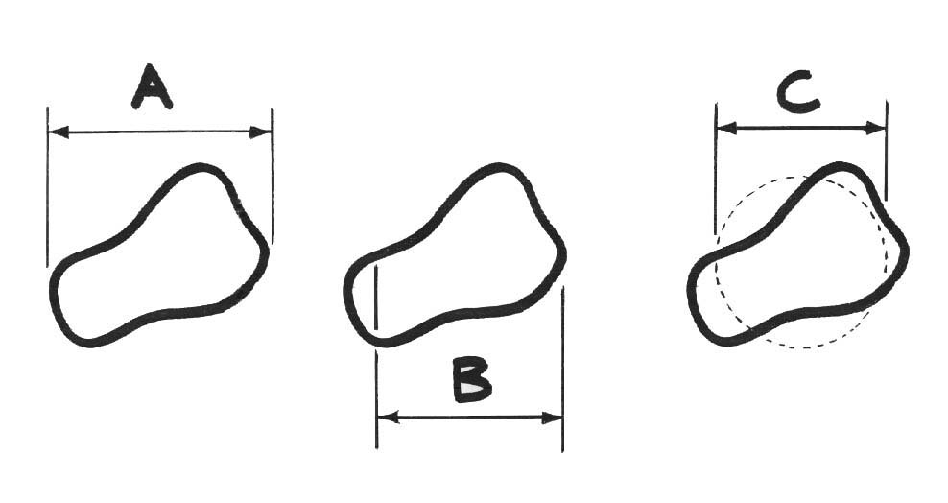
Particle Size
Feret’s Diameter
Martin’s Diameter
Projected area Diameter

Slide 4
Particle Size
Latest system of defining particle size is by comparison with standard configuration (sphere) → That is called the equivalent size / equivalent diameter or Equivalent Spherical Diameter (ESD) of irregular particle defined as:
The size of the spherical particle having the same controlling characteristics as the particle under consideration.

Slide 5
Particle Size in terms of controlling characteristics
For defining the size of catalyst particle, surface area is chosen as controlling characteristics.
Surface diameter: Diameter of the spherical particle having the same surface area as the particle.

Slide 6
Particle Size in terms of controlling characteristics
Settling velocity of particle in a liquid is very much controlled by the volume of the particle.
Volumetric diameter: Diameter of the spherical particle having the same volume as the particle under consideration.

Slide 7
Particle Size in terms of controlling characteristics
Motion of liquid drops in a gas depend not only on liquid drop volume but also at interfacial tension at the gas-liquid interface. Both the volume and surface area of liquid drop are controlling parameters here.
Volume Surface diameter: Diameter of the spherical particle having the same volume per unit surface area as the liquid drop under consideration.

Slide 8
Sphericity
Sphericity is a measure of roundness of a shape of particle.
Sphericity is defined for a non-spherical particle
Dimensionless quantity
Sphericity is s/v ratio for a sphere of diameter D_{p} divided by s/v ratio of particle whose nominal size is D_{p}.

Slide 9
Sphericity
To equate some property of the irregular shaped particle to a sphere with the same property, e.g. same volume as particle:
Has the same volume as a sphere

Slide 10
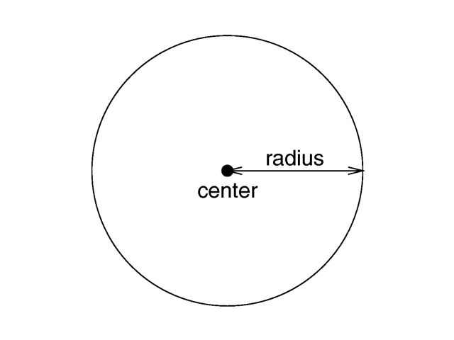
Sphere

Slide 11
Ideal Cylinder

Slide 12
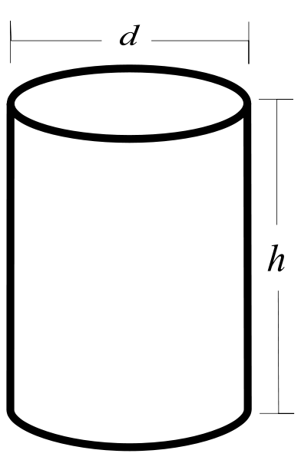
Long Cylinder

Slide 13
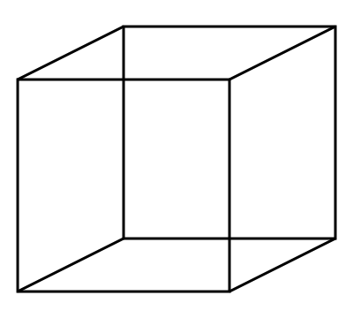
Cube

Slide 14
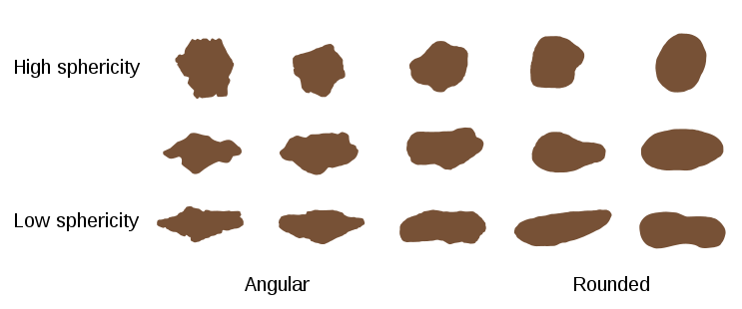
Sphericity of various particle shapes

Slide 15
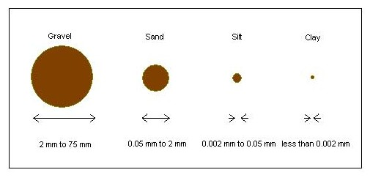
Measurement of Particle size (Regular)

Slide 16
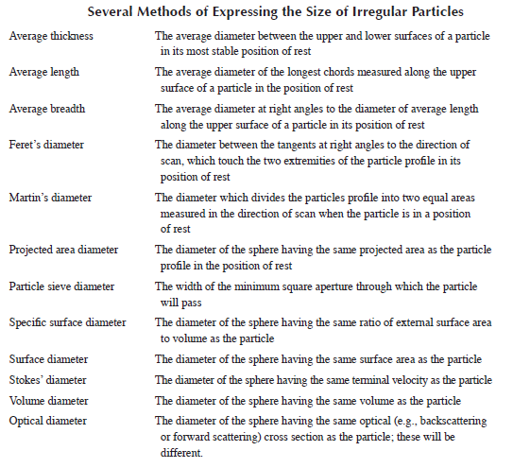

Slide 17
Units used for particle size depend on the size of particles:
Coarse particles: inches or millimetres
Fine particles: screen size
Very fine particles: micrometers or nanometers
Ultra fine particles: surface area per unit mass, m²/g

Slide 18
Particle Size Analysis Methods
1. Visual methods (e.g., optical, electron, and electron microscopy and image analysis)
2. Separation methods (e.g., sieving, classification, impaction, electrostatic differential mobility)
3. Scanning methods (e.g., electrical resistance zone, laser diffraction)
4. Surface methods (e.g., permeability, adsorption)

